Slide 1


Secure Cross-Platform VPN with Java-Based GUI & OpenVPN Integration
Presented by
Srijato Das

Slide 2





















CONTENTS
1. Project Overview
2. Problem Statement
3. Objectives
4. System Architecture Diagram
5. GUI Design & Interaction
6. User Workflow
7. VPN Platform Support
8. Authentication System
9. Logging Mechanism
10. Security Features
11. Execution & Process Handling
12. IP Masking & Browsing
13. Testing & Verification
14. Challenges Faced
15. Deployment Plan
16. Future Enhancements
17. Summary & Impact
18. Flowchart – User Connection Flow
19. Flowchart – Internal Logging
20. Thank You

Slide 3

1. Project Overview
Introduction
Key Features
• This project presents a secure, cross-platform Virtual Private Network (VPN) solution.
• Java-based desktop VPN client
• OpenVPN integration with full GUI control
• Built using Java for the GUI and core logic, it seamlessly integrates OpenVPN for tunneling and IP masking.
• Supports Android, iOS, Linux, Windows, macOS configuration files
• The application supports five platforms: Windows, macOS, Linux, Android, and iOS.
• Platform-agnostic VPN configuration
• Provides user authentication, server configuration selection, and logging—all within a unified GUI.
• Secure authentication & logging
• Real-time status updates

Slide 4


2. Problem Statement
1
Current Issues in VPN Solutions
2
Challenges Identified
• In today's digital age, data privacy and geo-restriction circumvention are critical concerns.
• Limited GUI-based VPN clients with full cross-platform configuration support.
• Most VPN clients lack cross-platform GUI support for dynamically selecting VPN configurations.
• Manual and error-prone VPN connection methods.
• Insecure or unlogged access.
• Many VPN applications rely on manual command-line interactions and do not centralize authentication, logging, and connection management.
• Lack of centralized access management.

Slide 5



3. Project Objectives
Key Project Goals and Aspirations
The primary goal of this initiative is to develop a robust desktop VPN application that meets the following criteria:
Highly Secure: Ensuring user data and privacy are protected through advanced encryption techniques.
Completely GUI-Based: Featuring a user-friendly graphical interface that enhances overall usability.
Effortlessly Configurable Across Multiple Platforms: Allowing seamless integration with various operating systems such as Windows, macOS, and Linux.
Automated OpenVPN Connection Management: Streamlining the process of connecting to OpenVPN servers without user intervention.

Slide 6
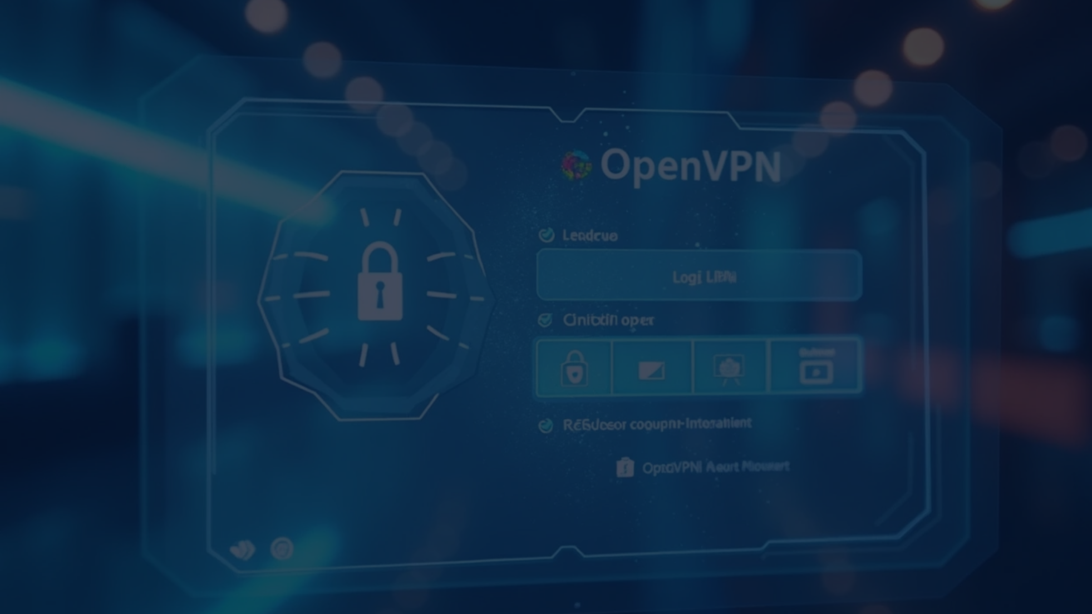










Main Goals and Objectives
Intelligently choose and load the appropriate configuration files tailored for each specific platform, ensuring compatibility and optimal performance.
Create a seamless and user-friendly authentication process that ensures ease of use while maintaining high security standards.
Initiate OpenVPN with the correct configuration settings directly from a user-friendly graphical user interface, simplifying the user experience.
Conceal the user's IP address and encrypt all internet traffic to provide enhanced security and protect sensitive information from potential threats.
Ensure all VPN events are logged in a secure manner while keeping track of user activities, thereby safeguarding user privacy and data integrity.

Slide 7


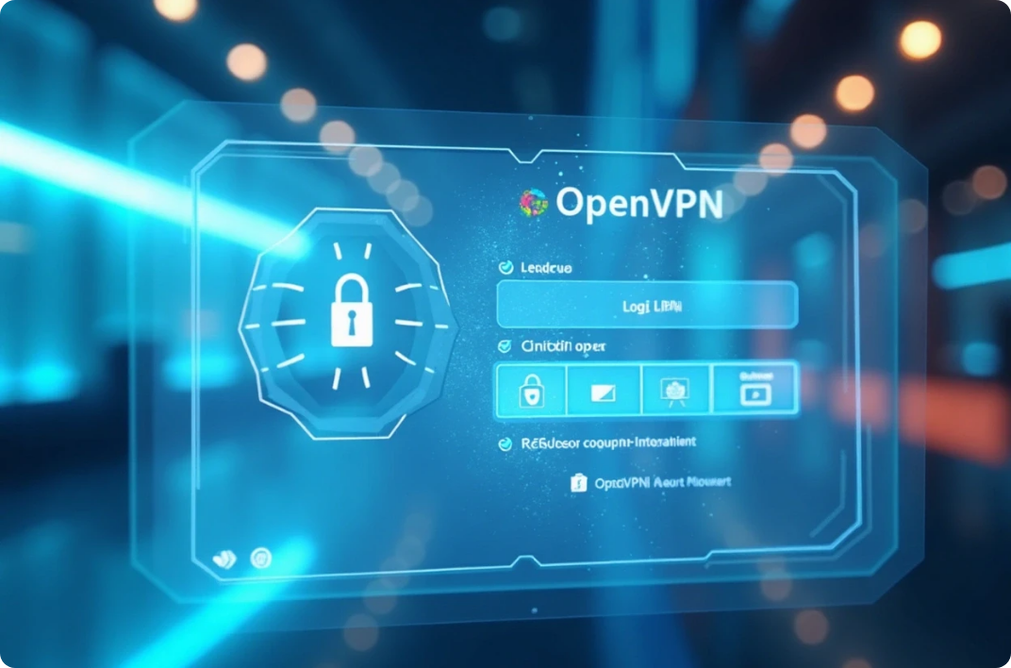
4. Comprehensive System Architecture Diagram
Key Components of the System Architecture
The overall architecture is structured around three essential components that work in tandem:
Graphical User Interface Layer built using Java Swing for interactive user experiences
Central Core Logic Layer implemented in Java to manage all processing and data handling
Tunneling Layer utilizing OpenVPN to ensure secure and encrypted communication between clients and servers

Slide 8


Flowchart Overview and Explanation
Initiation Phase of the Process
Core Logic Processing Module
Final Connection Status and Feedback
The user launches the graphical user interface (GUI) to begin interacting with the system.
This layer securely saves the user's credentials and prepares the necessary configuration for establishing a connection.
The system displays the connection status both in the graphical user interface and records it in the system logs for monitoring.
1
2
3
4
5
User Credentials and Configuration Input
OpenVPN Session Initiation Procedure
The user is required to enter their unique username and password, along with selecting the desired platform for connection.
The OpenVPN process is initiated using the user authentication file along with the configuration selected earlier by the user.

Slide 9
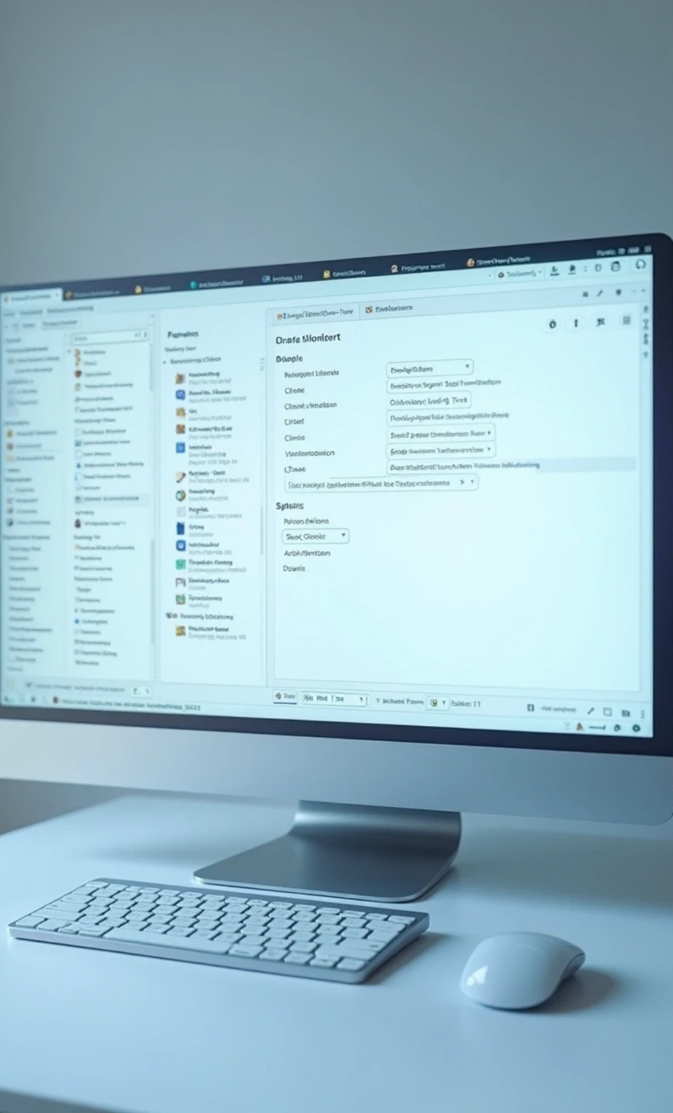
5. GUI Design & Interaction
GUI Features
The Graphical User Interface (GUI) is meticulously constructed using Java Swing, which is known for its versatility and ease of use. It features a well-organized layout that includes various dropdown menus, informative labels, user input fields, and responsive buttons, all designed to ensure a seamless and intuitive interaction experience for the user. Importantly, every action taken by the user is met with immediate and pertinent feedback, alongside comprehensive logging to enhance usability and tracking.

Slide 10






Overview of Interface Elements
2
The dropdown menu is powerful, allowing users to freely select their desired platform, making the operation more flexible and convenient.
The input box is designed meticulously to ensure that users can safely and conveniently enter their usernames and passwords for account security.
1
The selection tool helps users easily choose VPN configuration files for a smooth and seamless network connection experience.
3
The label clearly displays the current timestamp along with the log status, facilitating real-time monitoring for users.
5
"Connect VPN" button allows users to simply press it to start the connection process, ensuring quick access.
4

Slide 11



6. User Interaction
Operation Steps
The user interaction process includes key steps for a smooth experience and efficiency.
1
2
3
4
First, launch the app, which takes a few seconds for smooth operation.
Next, enter your ProtonVPN login details, ensuring they are accurate.
Choose your platform, like Android or Windows, and select the suitable version.
Then, select a configuration file that matches the chosen server.
5
6
7
8
Next, click 'Connect VPN' to start the connection process.
OpenVPN runs in the background, using your credentials for a secure connection.
The interface shows the connection status, success, and server location.
Finally, the VPN transmission starts, hiding your IP for privacy and security.

Slide 12






7. VPN Platform Support
Supported Platforms
The project includes full support for the following platforms by managing configuration directories per OS type:
Android
iOS
Linux
macOS
Windows

Slide 13
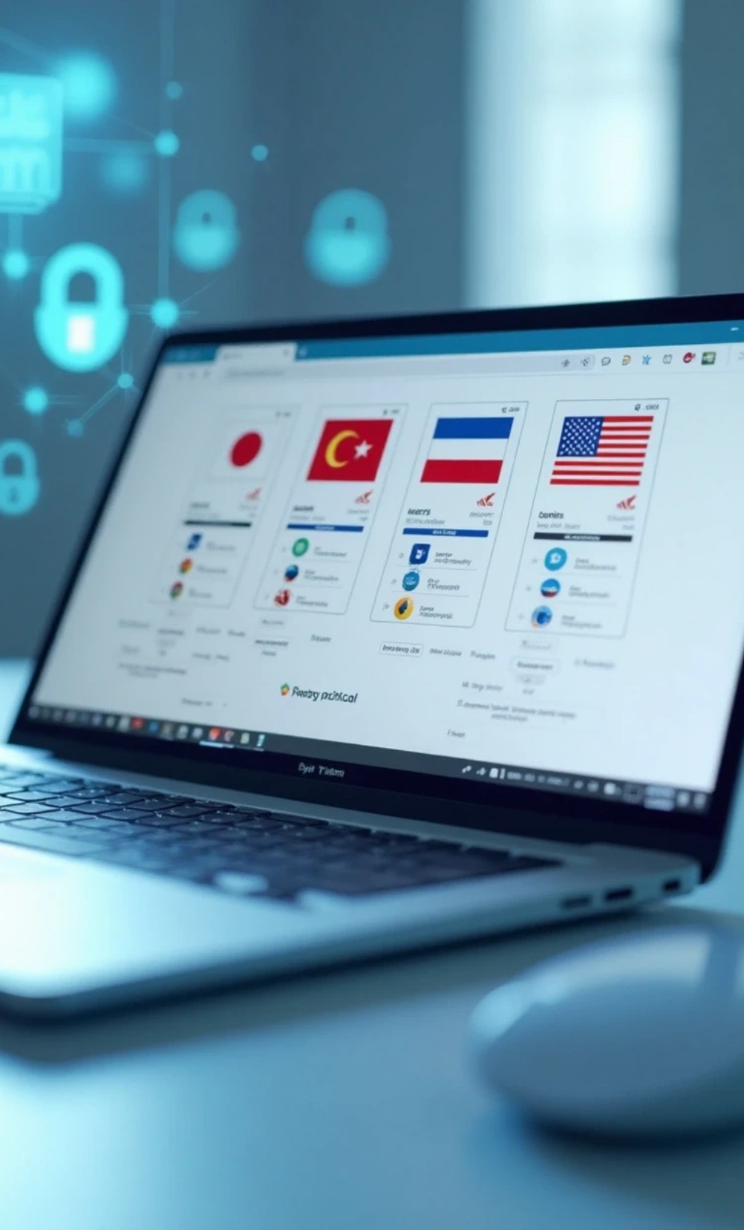

Directory Structure
Each platform folder contains:
Country-wise .ovpn configuration files (Japan, Netherlands, US)
Protocol support: UDP
OpenVPN Configuration Files
Android
iOS
Linux
macOS
Windows

Slide 14

8. Comprehensive Authentication System
Robust and Secure Login Process
The secure login process for the Virtual Private Network (VPN) is meticulously designed and thoroughly executed to ensure an exceptional level of security while safeguarding users' sensitive information. This multi-layered process is facilitated by the use of unique credentials provided by ProtonVPN, empowering users to connect utilizing the esteemed OpenVPN protocol or the highly regarded IKEv2 protocol. Both protocols are well-respected in the cybersecurity field for their robust security capabilities, allowing users to surf the internet safely and privately, free from the concerns of unauthorized intrusions or potential data breaches that could jeopardize their personal information.

Slide 15

Comprehensive Authentication Features
1
2
3
4
The GUI collects usernames and passwords securely, ensuring sensitive data is encrypted and protected.
Credentials are temporarily stored in vpn-auth.txt, streamlining authentication while prioritizing user security.
Credentials are sent to OpenVPN with --auth-user-pass, allowing secure connections without risking user data.
After authentication, the temporary file is deleted to remove sensitive info, enhancing user privacy and security.

Slide 16

Essential Security Practices
1
It is crucial to ensure that credentials are not hardcoded in the codebase, as this practice can lead to significant security vulnerabilities and unauthorized access.
2
Providing an option to extend functionality with an encrypted credential store not only enhances security but also ensures sensitive information is safely managed and less susceptible to breaches.
3
The use of the auth-nocache flag in OpenVPN is vital as it ensures that sensitive authentication data is not cached in memory, thereby maintaining a higher level of memory safety and reducing the risk of exposure.

Slide 17

9. Comprehensive Logging Mechanism
Advanced and Robust Logging Features
This system boasts a meticulously crafted and intricately designed logging mechanism, which stands out for its robustness and reliability. This logging mechanism is not just an afterthought; it is seamlessly woven into every component of the system. As a result, it significantly boosts the efficiency and effectiveness of debugging and auditing processes. The performance achieved through this implementation is not just high; it reaches exceptional levels, making it an invaluable tool for system administrators and developers alike.

Slide 18




System Log Files
client.log – Contains detailed output of VPN graphical user interface messages and OpenVPN processes, which can help users troubleshoot connection issues.
server.log – Logs server-side information when used with a custom proxy, providing in-depth information about how the server processes requests.
response.log – Records summary information about the authentication process or VPN connection results, helping to assess the success rate and security of connections.
login_history.txt – Records timestamped login history to facilitate tracking user activity and auditing security events.

Slide 19

Logging Strategies Overview
Every single log entry is meticulously crafted to include essential elements such as a precise timestamp, indicating when the event occurred, the origin or source of the log to ensure traceability, and a detailed message that comprehensively describes the context surrounding the log entry, providing valuable insight for future analysis.
The graphical user interface (GUI) serves a dual purpose; it not only provides visually appealing representations of data and processes but also effectively conveys crucial status messages that keep users informed about their actions, system performance, and any potential issues that may arise.

Slide 20

10. Essential Security Features
Robust Multi-Layered Security
A comprehensive and meticulously organized series of robust security layers work in perfect harmony to guarantee the establishment of safe and secure connections. This intricate framework not only fortifies the integrity of the communication channel but also delivers stringent protection for sensitive data, such as personal information or financial details, throughout its transmission, ensuring that unauthorized access is effectively thwarted.

Slide 21






Security Layers
TLS/SSL encryption via OpenVPN
Encrypted OpenVPN tunnels
Username/password not stored persistently
Real IP masked during browsing
No DNS or WebRTC leaks (verified)

Slide 22



Future Additions
Kill switch
Encrypted credential manager
OTP/MFA

Slide 23

11. Execution & Process Handling
Process Launch
Launching OpenVPN is achieved by utilizing Java's ProcessBuilder, an incredibly robust and versatile tool designed to streamline the process. This tool not only allows for the dynamic configuration of various file paths but also enhances the management of system resources. Moreover, it enables comprehensive log capturing, which plays a crucial role in effective monitoring and debugging, ensuring that any issues can be promptly identified and addressed.

Slide 24

Thank You

